Slide 1

Measuring the Value of the New Haven Promise

Slide 2



What is the Promise?
“New Haven Promise is Model for Obama Community College Proposal”
WTNH News, Jan 2015
“New Haven, Seeking to Get More Students Into College, Will Pay Tuition”
New York Times, Nov. 2010
“Next Class of City Students to Begin College as New Haven Promise Scholars”
3.0 GPA
90% Attendance
New Haven Public Schools Student
40 Hours of Community Service
YaleNews, Aug. 2013
2

Slide 3
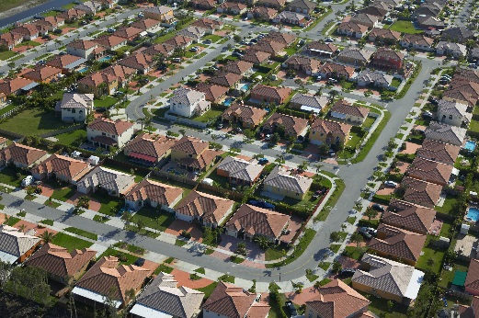
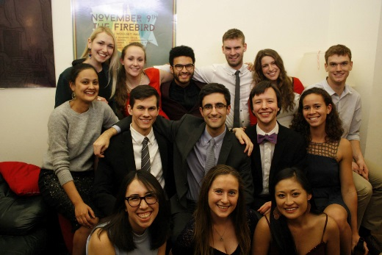







The Economic Model

Slide 4
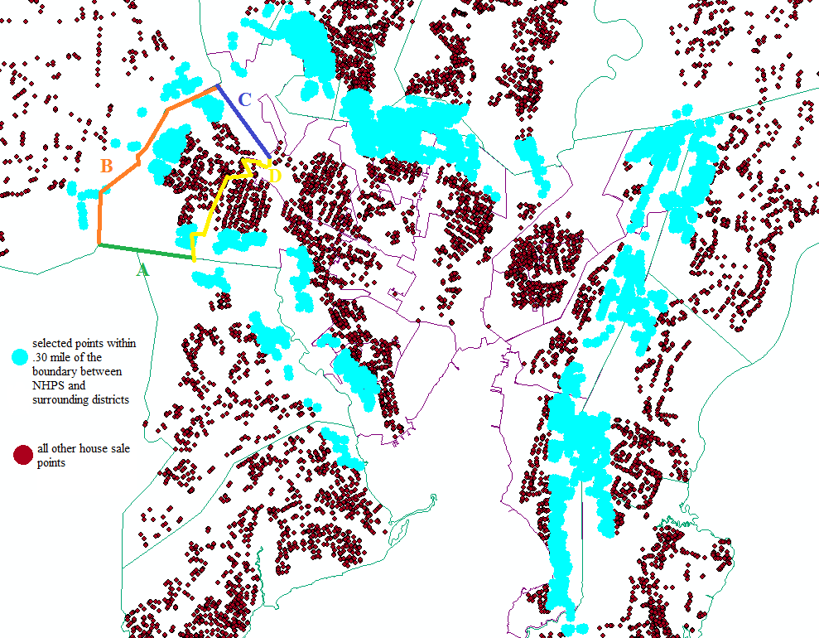
Data Analysis
Woodbridge
Hamden
North Haven
House Characteristics
3 bedrooms
1.5 baths
1,850 square feet
.24 acre lot
Built in 1920
----------------------------------------------
Spatial Data
Within .30 mile of New Haven Public Schools district line
In Davis Street School district
Associated with boundary B
Census Information
50% white
35% black
11% Hispanic
Median income: $42,500
New Haven
East Haven
West Haven
4

Slide 5
House Values: How Much is a One S.D. Increase in Test Scores Worth?
$12,932
$24,989
Additional Value of CMT scores post-2011
For All Years with Boundary Fixed Effects
$5,553
For All Years
5

Slide 6
Who is Motivated By the New Haven Promise?
+.242
+.120
New Haven 9th Grade High GPAs
New Haven 9th Grade Middle GPAs
Low GPAs - baseline
6

Slide 7
Who are (and aren’t) the Promise Scholars?
930
25%
Residency
Students Graduated NHPS in 2014
Ineligible because they do not live in NHPS, or started attending NHPS post-9th grade
184
Students received the Promise scholarship
GPA requirement
49%
Disqualified by GPA alone (30%), or because of low attendance and low GPA (19%)
2.5%
Attendance
24 students were ineligible by attendance alone
*Remaining 3.5% represents students who were qualified for Promise but did not apply for it/receive it
20%
Received Promise
7

Slide 8
Enrollment Decline is Reversing
+600
8

Slide 9
Conclusions
Real Estate
Student Effort
The School District



c
9

Slide 10
Thanks!

Success Secrets

Prof. Doug McKee
Master H and Jenny
Tax Assessors of CT
NHPS
Everyone who listened to my struggles with GIS
Lemon drops oat cake oat cake sugar. Tiramisu pie sesame snaps. Sweet roll jelly wafer cake oat cake.
Data
Lemon drops oat cake oat cake sugar. Cake pie sesame snaps.

Technology
Lemon drops oat cake oat cake sugar. Cake pie sesame snaps.
c
10

